Slide 1
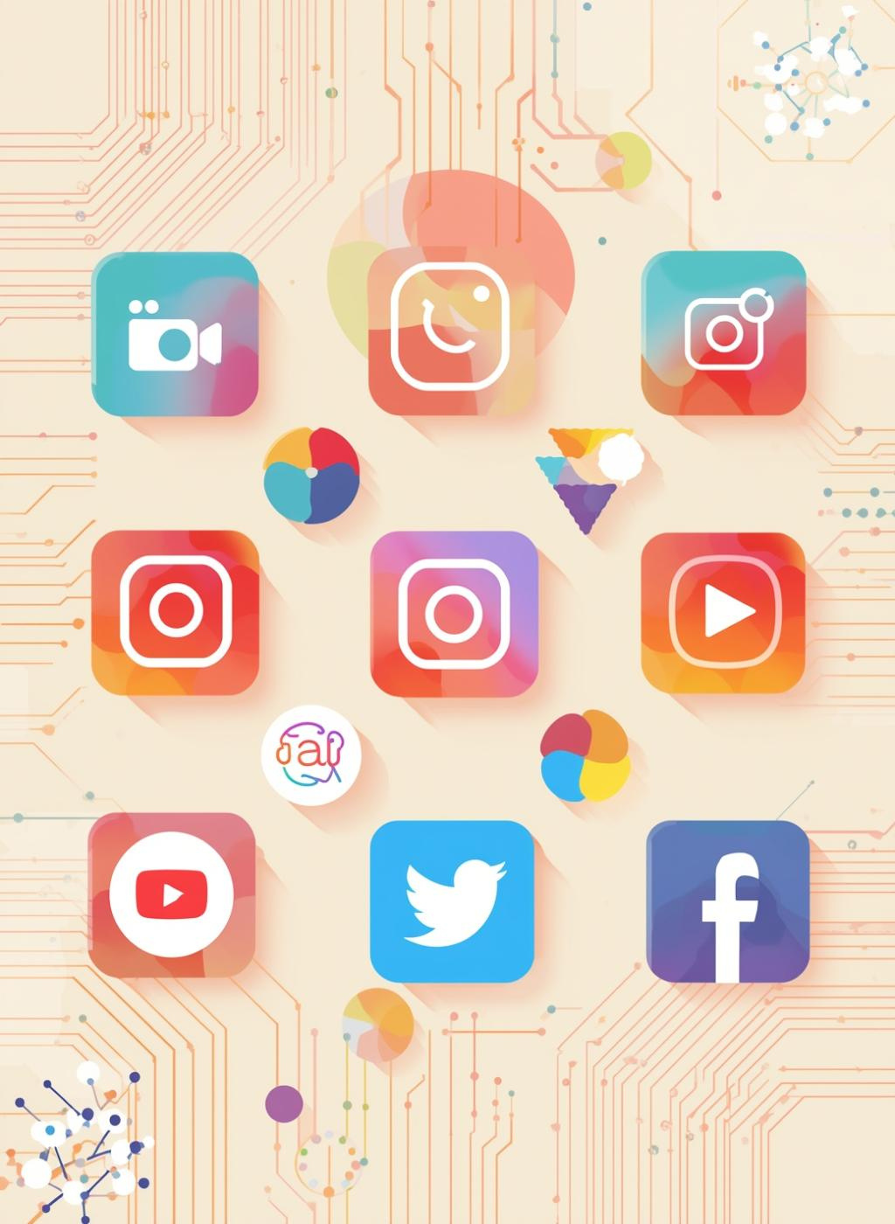


The Rise of Influencer Market
March 12, 2026
(From Viral Clips to a $500B Economy)
The Trust Shift: 92% of users now trust individual creators over traditional brand advertisements.
The Economy: A $500B Global Powerhouse growing at 25% annually, driven by Reels and Shorts.
YASH GOEL

Slide 2
The 2026 Playbook : Why It Works
Micro-Power: Creators with <50k followers see 7x higher engagement than celebrities. (Niche > Mass)
The 3-Click Pipeline: Reduced latency from Discovery → WhatsApp → UPI Payment to under 30 seconds.
UGC Engine: User-Generated Content is 3x more effective at converting sales than studio-shot ads.
The Verdict: If it looks like an ad, it’s a fail. If it feels like a friend’s tip, it’s a sale.

Slide 3
Thank you!
ANY QUERIES ?

